Slide 1
Public
Meeting #1
January 30, 2018

Slide 2
Meeting Outline
Mayor’s Introduction
Presentation
Q&A
Group Activities
Wrap-up

Slide 3
Presentation Outline
Introduction
Existing Conditions
Market Assessment
Break-out Setup

Slide 4
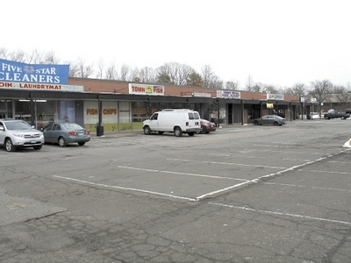
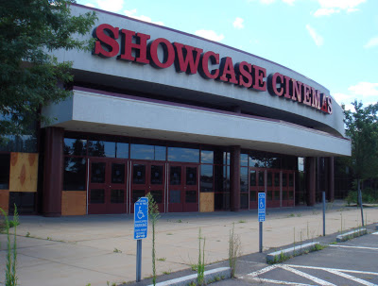
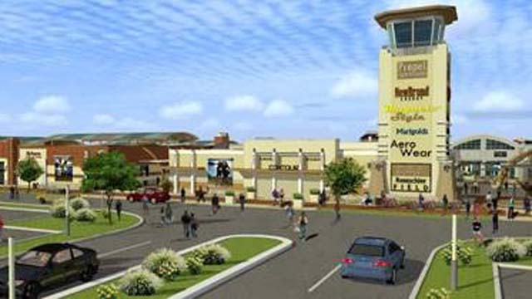
Introduction
A Vibrant Future for Silver Lane!
  CRCOG Transportation Study
  Brownfields Area-Wide Redevelopment (BAR) Study
  Working Cities Challenge

Slide 5
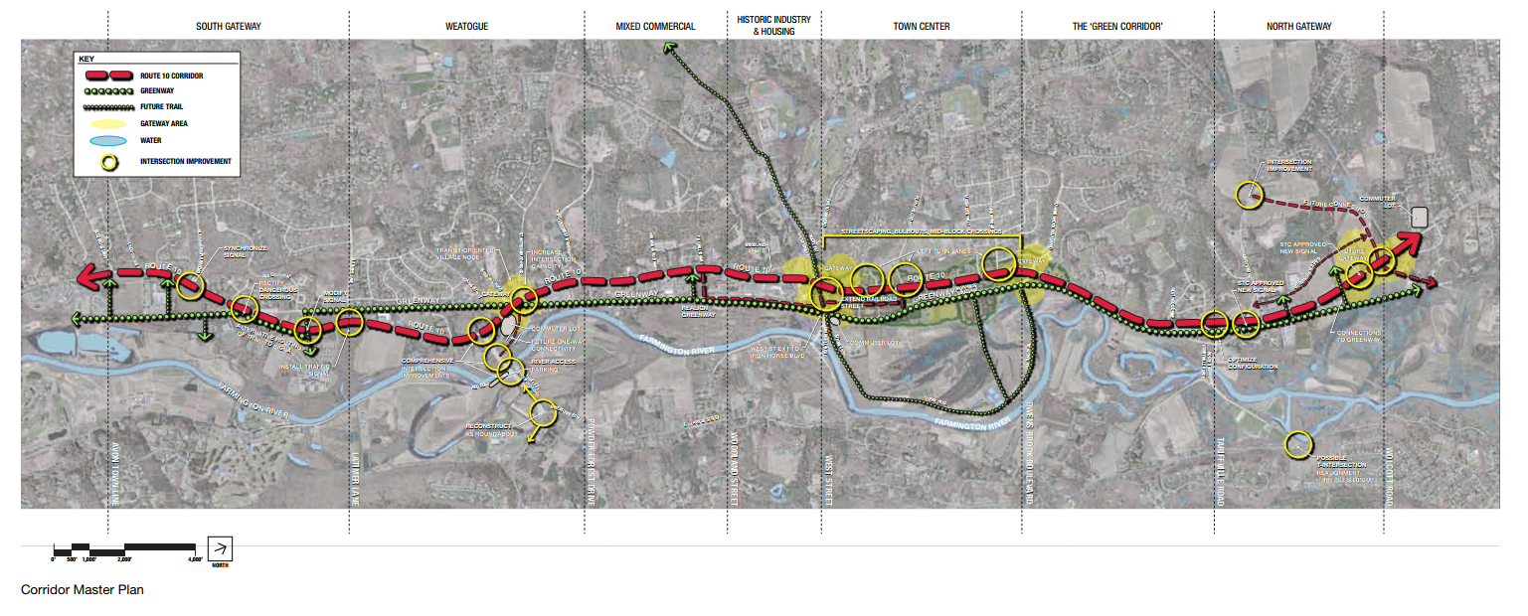
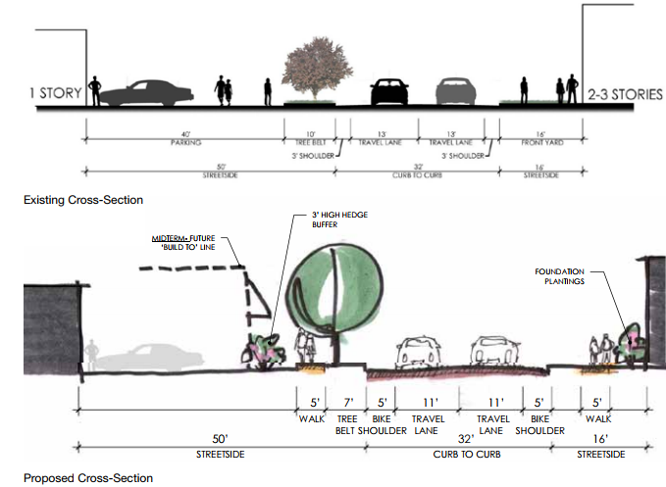
Introduction
What is a corridor study?
  A multi-modal planning process to prepare a master plan for a transportation corridor

Slide 6
Introduction
Why prepare a corridor master plan?
  Promote orderly growth
  Encourage efficient use of public infrastructure
  Assure there is adequate infrastructure to accommodate growth
  Provide guidelines for roadway improvements that all parties (Town, State, developers, property owners) can refer to

Slide 7
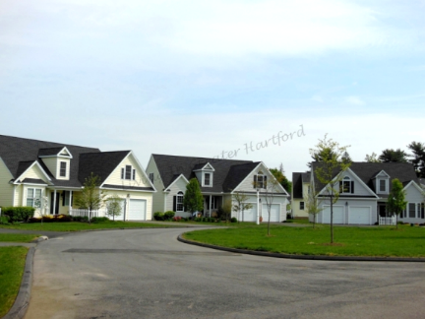
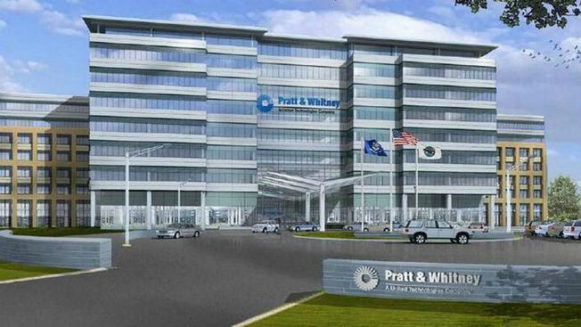
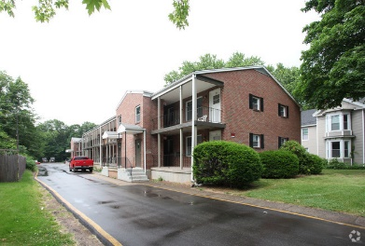
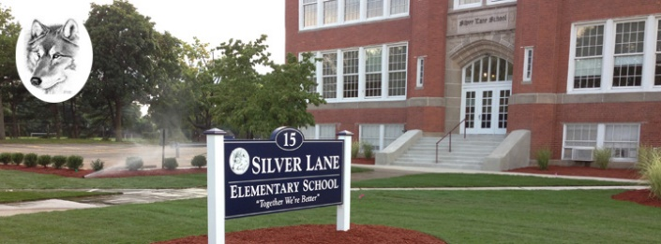
Introduction
Traditionally
  Facilities Plan - Identify needed transportation facility improvements to assure facilities can handle current and future traffic efficiently and safely
New Direction
  Context sensitive plans – recognizes that transportation facilities are one piece of the larger community fabric
  Facilities need to fit into communities they pass through

Slide 8
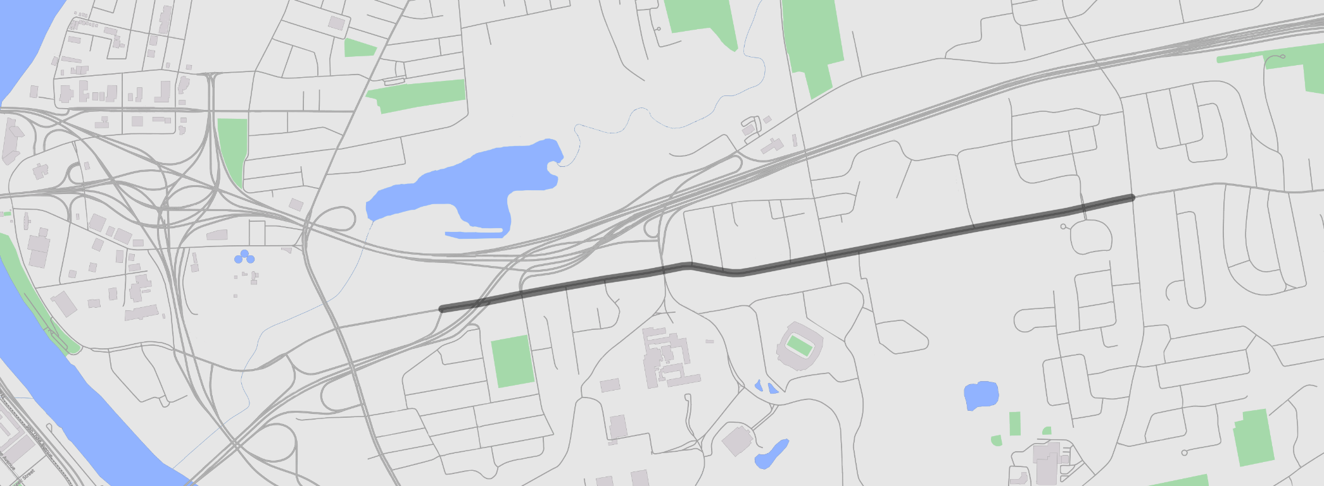

Existing Conditions Analysis
Study Area
Main Street
Interstate 84
Interstate 84
Simmons Road
Forbes Street
Silver Lane
Silver Lane
Route 2
Route 5
Silver Lane
Elementary
School
Rentschler
Field
Routes 5/15
Notes:
Set context, CT River, RT 5, I-84, RT 2
Apx 2 miles, RT 15 ramps to Forbes Street
Slightly larger area for some other topics
Describe breakout groups

Slide 9
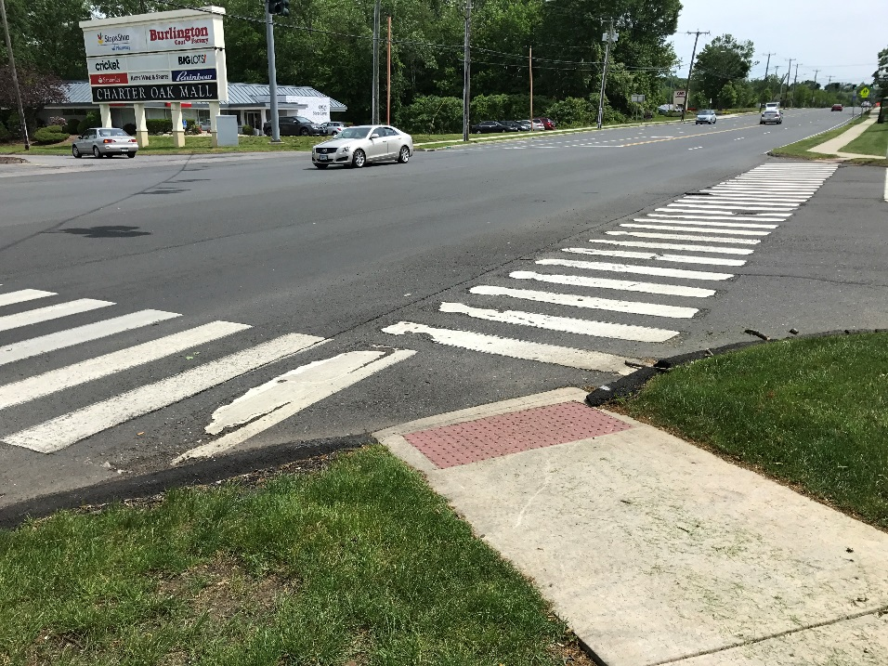
Existing Conditions Analysis
Functional Classification
  Minor Arterial
Average Daily Traffic (ADT) Range
  11,400-17,600 vehicles per day
Notes:
Define Minor Arterial – serves as conduit between collectors and destinations (development OR access to freeways)
Transition with volumes

Slide 10
Existing Conditions Analysis
Average Daily Traffic (2012)
11,400
17,600
Roberts Street
Mercer Avenue
14,000
Route 15
On- & Off-Ramps
Forbes Street
Main Street
10,500
Notes:
Transition is to operations

Slide 11
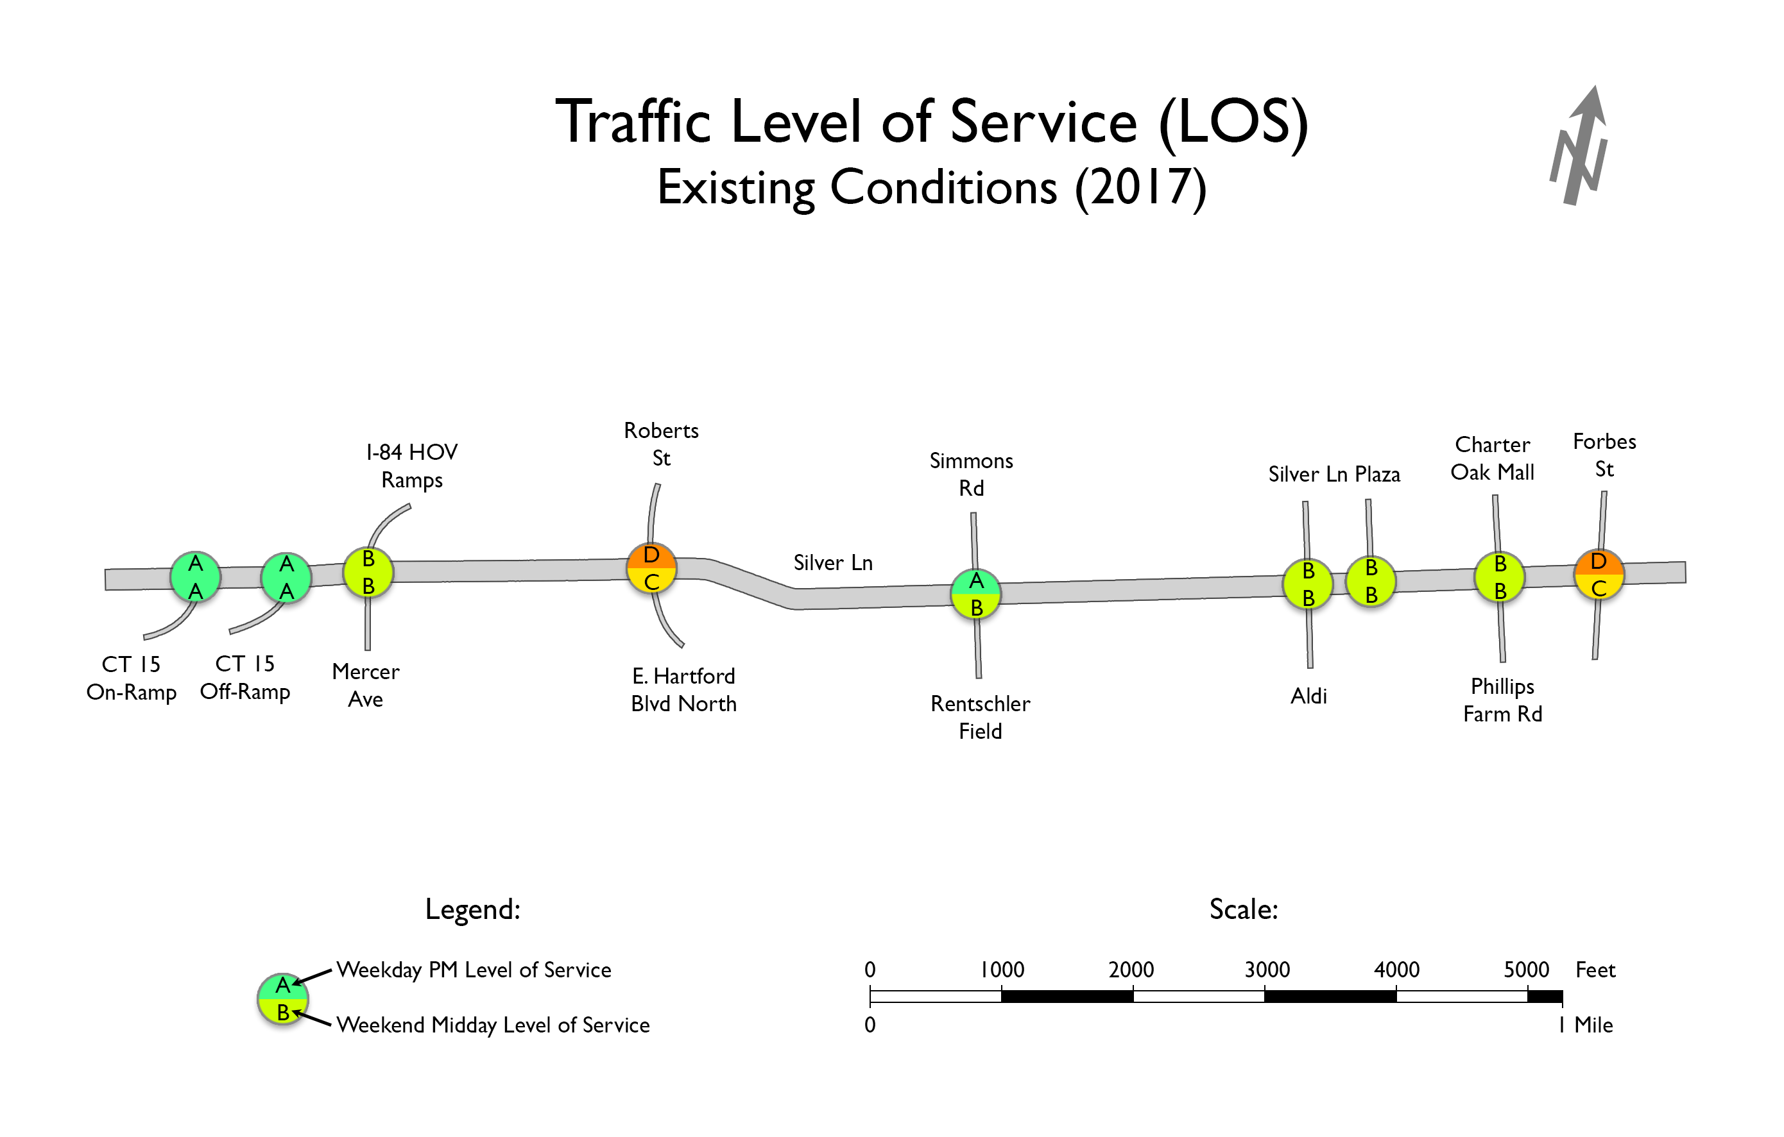
Existing Conditions Analysis
Existing Traffic Operations
LOS | Delay (sec/veh)
A | < 10
B | 10 - 20
C | 20 - 35
D | 35 - 55
E | 55 - 80
F | > 80
Notes:
Transition is to crashes

Slide 12
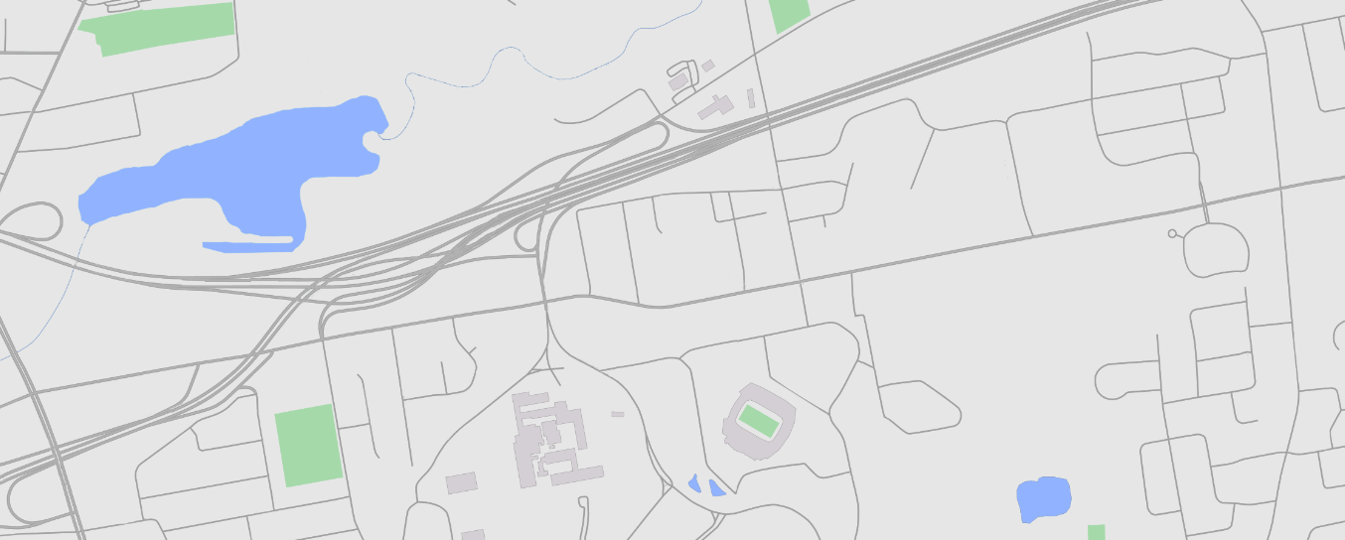
Existing Conditions Analysis
Segment Crash Data
Interstate 84
Main Street
Forbes Street
Simmons Road
Interstate 84
Legend
Below average rate in segment
Above average rate in segment
Route 5
Route 15
Mercer Avenue
Notes:
Explain rate methodology – note spikes in areas with increased development (access)

Slide 13
Existing Conditions Analysis
Intersection Crash Data
Interstate 84
Main Street
Simmons Road
Interstate 84
Forbes Street
Legend
Below average rate at intersection
Above average rate at intersection
Route 5
Route 15
Mercer Avenue
Notes:
Intersections with highest volumes (despite fact that the statistic regulates FOR volume)

Slide 14
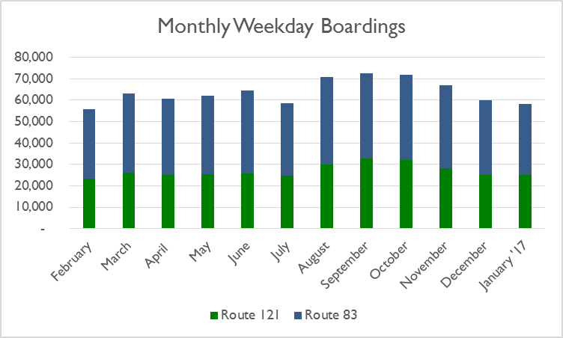

Existing Conditions Analysis
Bus Routes & Stops
Interstate 84
Main Street
Simmons Road
Interstate 84
Forbes Street
121
83
Bus shelters
Route 15
Route 5
Mercer Avenue
Notes:
Two routes along Silver Lane – one local one Fastrak
Will discuss shelters more as we continue
Ridership data animates

Slide 15
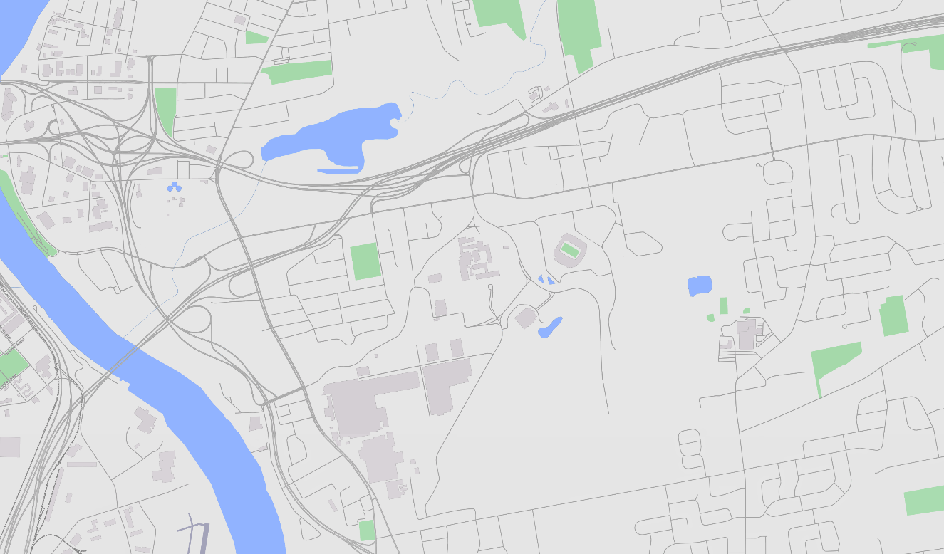
Existing Conditions Analysis
Surrounding Bus Route System
121
95
83
Interstate 84
Simmons
Road
121
121
Forbes Street
Silver Lane
83
87
Silver Lane
83
Route 2
87
91
95
87
Main Street
87
91
Brewer Street
Notes:
Connections to north/south routes offered at Main and Forbes

Slide 16
Existing Conditions Analysis
Surrounding Multi-use Trail System
Interstate 84
Main Street
Simmons Road
Interstate 84
Charter Oak
Greenway
Off-Road
Silver Lane
Forbes Street
Silver Lane
Route 2
Route 5
Charter Oak
Greenway
On-Street
East Coast Greenway/
Riverfront Recapture
Off-Road
Main Street
East Coast Greenway
On-Street
Brewer Street
Notes:
Potential to connect

Slide 17
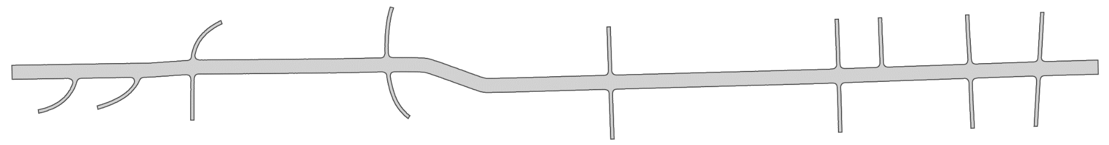
Existing Conditions Analysis
Bicycles and Pedestrians
3
6
3
8
0
12
2
26
16
11
2
2
1
5
7
11
18
10
9
2
1
3
3
2
Notes:
Transition is to crashes

Slide 18
Existing Conditions Analysis
Sidewalk Gaps
Interstate 84
Main Street
Simmons Road
Interstate 84
Silver Lane
Forbes Street
Route 15
Legend
Sidewalk Gap
Main Street
Mercer Avenue
Notes:
Transition is to crashes

Slide 19
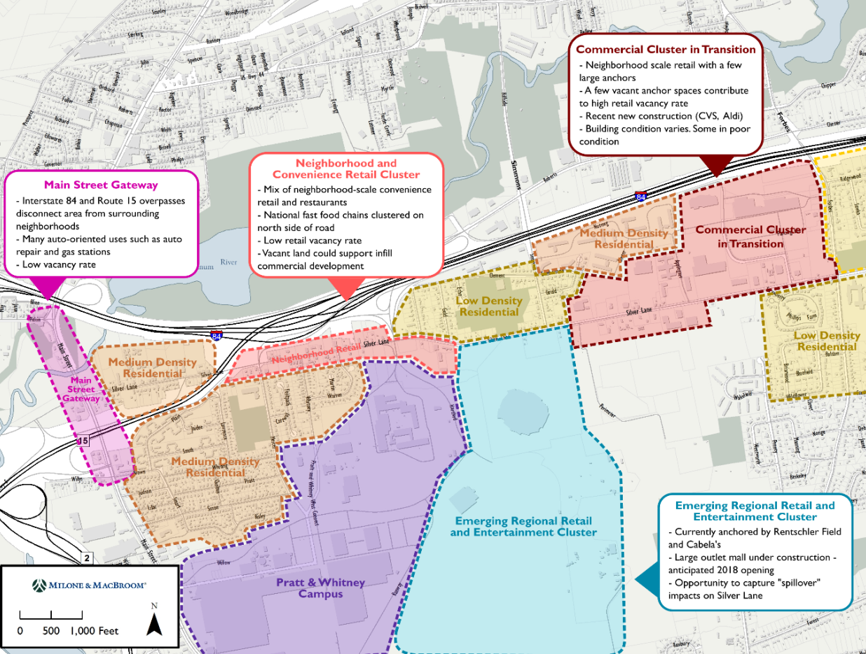
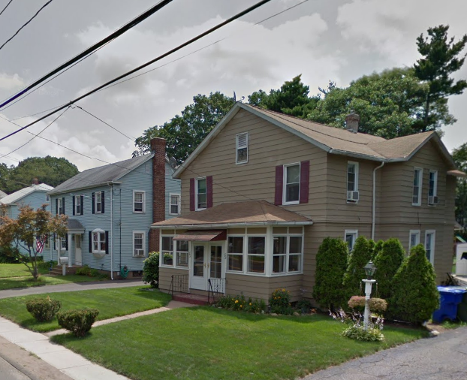
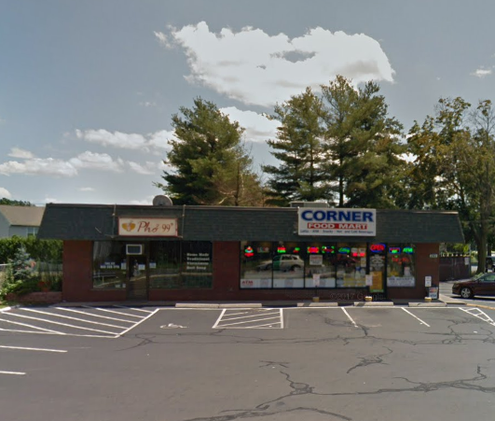
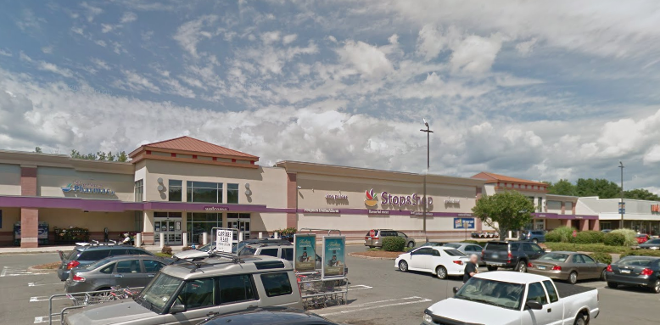
Existing Land Use
19

Slide 20
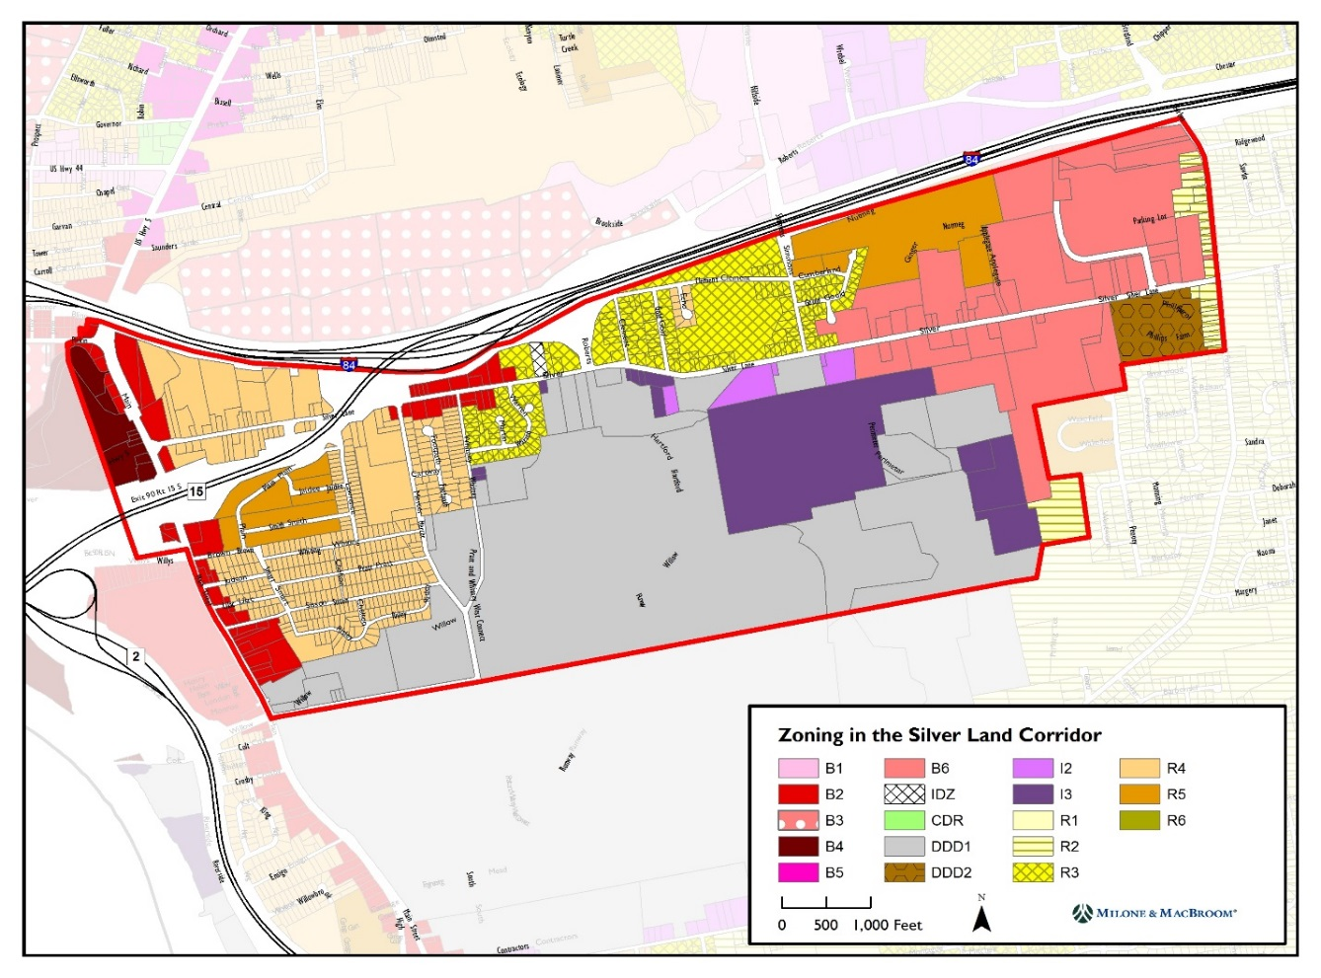
Existing Zoning
Not an official zoning map
20

Slide 21
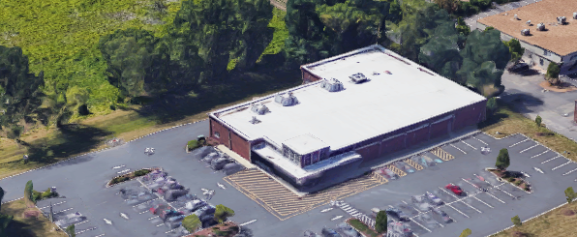
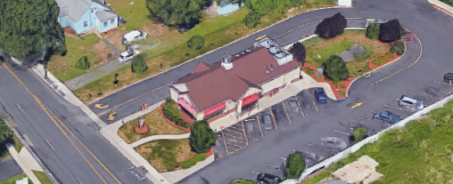


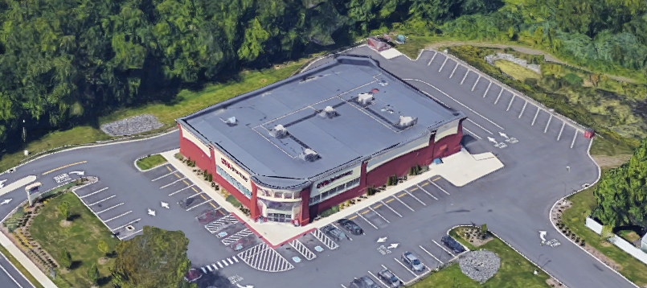
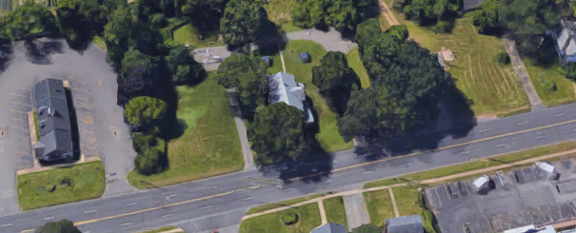


Land Use: Recent Developments
Aldi Supermarket
Dunkin Donuts
Address: 801 Silver Lane
Year Built: 2008 Size: 17,000 SF
Address: 364 Silver Lane
Year Built: 2009 Size: 2,400 SF
CVS Pharmacy
Dollar General
Address: 972 Silver Lane
Year Built: 2012 Size: 14,500 SF
Address: 735 Silver Lane
Year Built: 2017 Size: 7,500 SF
21

Slide 22
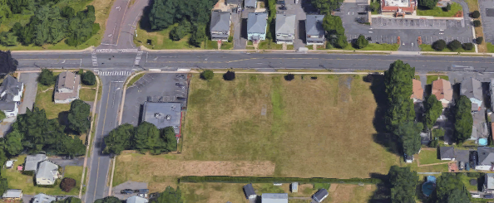
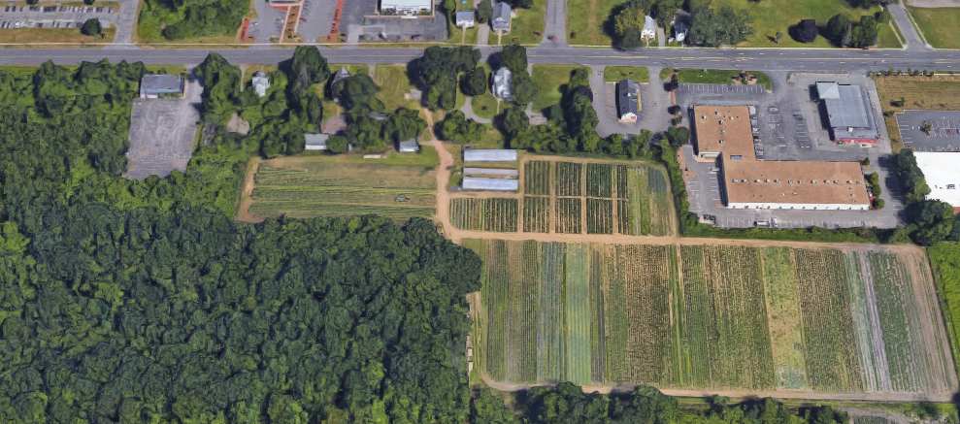
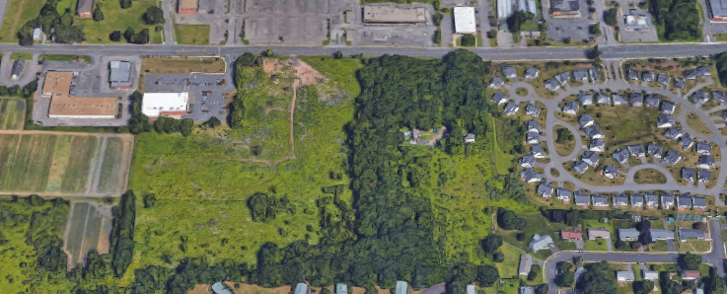
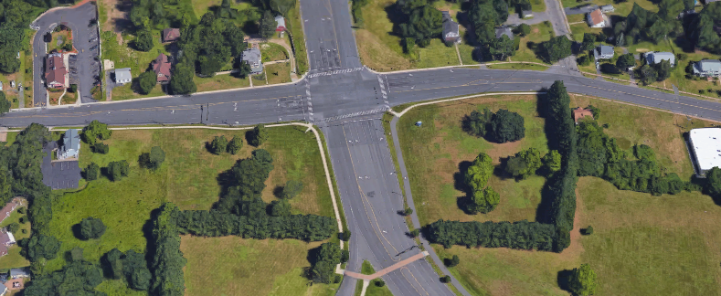
Land Use: Vacant Land
249-257 Silver Lane
675-711 Silver Lane
Parcel Size: 1.9 acres Zoning: B2
Constraints: Sewer easement, access
Parcel Size: 17.0 acres Zoning: B6
Constraints: Wetlands
825 Silver Lane
Pratt & Whitney Gateway
Parcel Size: 35.2 acres Zoning: B6
Constraints: Wetlands
Parcel Size: 6.8 acres Zoning: DDD1
Part of Rentschler Field Master Plan
22

Slide 23
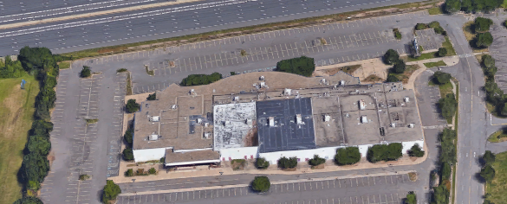
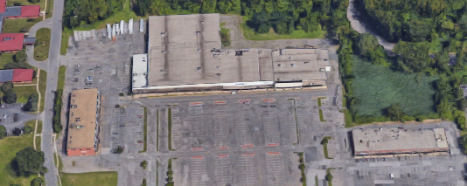
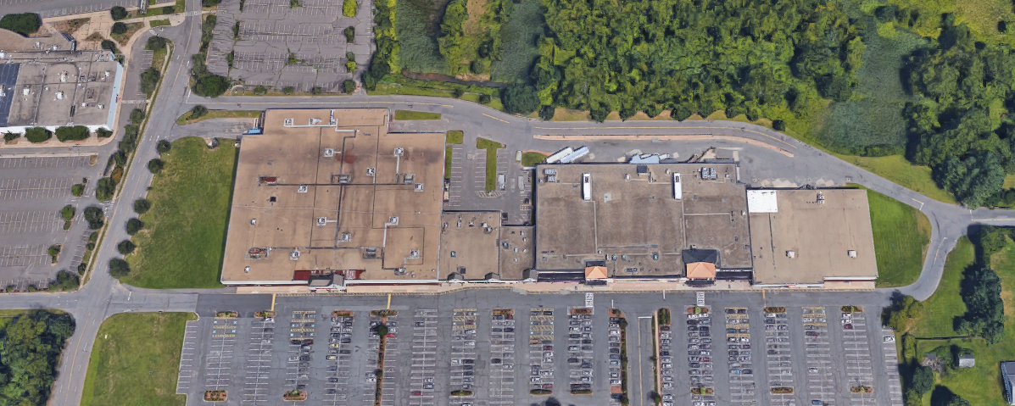
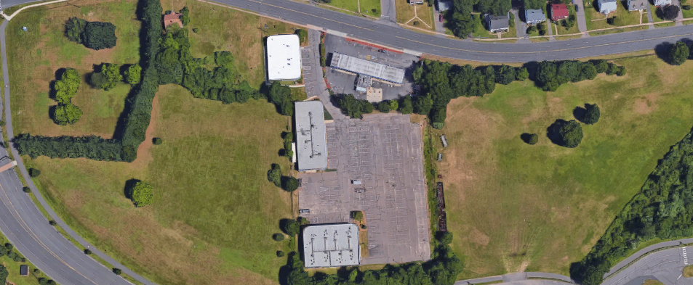
Land Use: Underutilized Properties
Showcase Cinemas
Silver Lane Plaza
Vacant Units: 1
Vacant Sq. Ft.: 65,847 SF
Vacant Units: 15
Vacant Sq. Ft.: 112,115 SF
Charter Oak Mall
467-479 Silver Lane
Vacant Units: 2
Vacant Sq. Ft.: 26,078 SF
Vacant Units: 2
Vacant Sq. Ft.: 14,857 SF
23

Slide 24
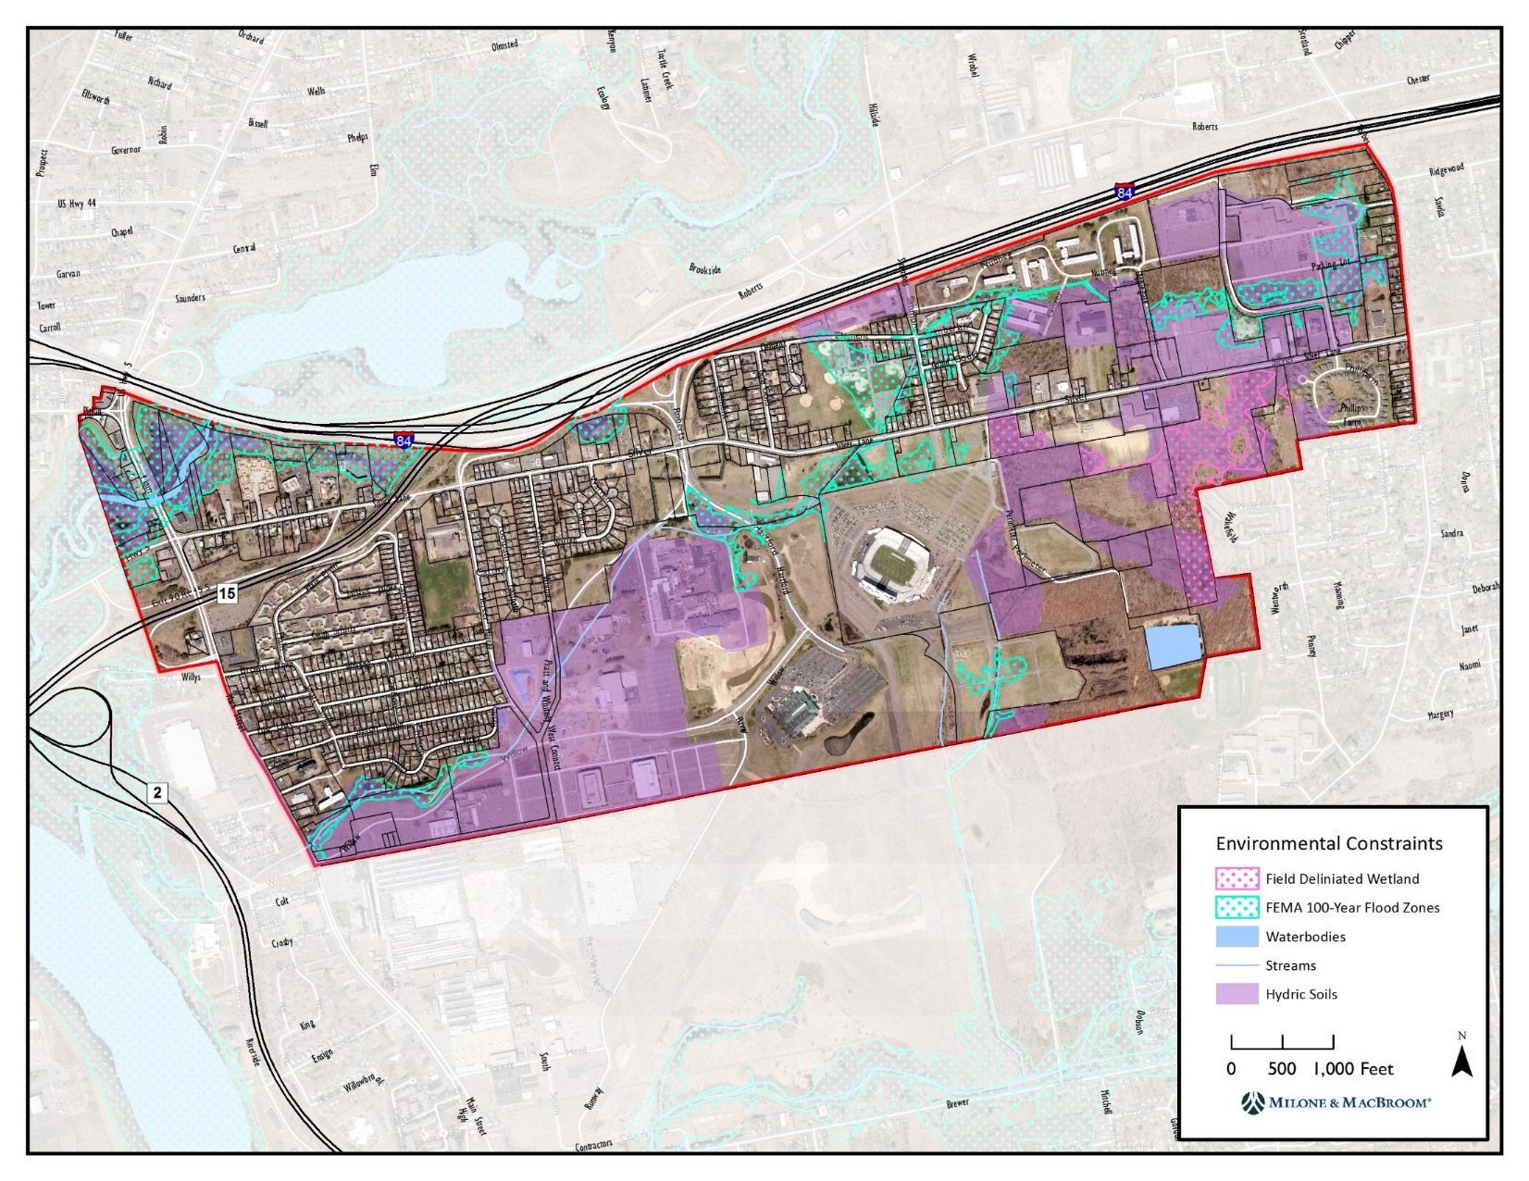
Environmental Constraints
24

Slide 25
Market Study - Retail
Takeaways
Oversupply of retail space in the corridor
Vacancy is concentrated in older “big box” type developments in the eastern end of the corridor.
Loss of the Forbes Street interchange in the 1980s contributed to decline of retail in this area
Strategies
Unique, niche use or cluster of niche uses needed to stimulate the traditional commercial core of Silver Lane (near Forbes Street)
Need to reposition the large vacant commercial properties to new uses that are more economically viable
More local spending power needed to support neighborhood retail in the corridor – new housing development
Properties that are visible to Rentschler Field campus traffic (near Roberts Street) have the greatest opportunity to capture spillover retail development
25

Slide 26
Market Study - Housing
Takeaways
Regional growth in multi-family housing over the last decade.
Pratt & Whitney hiring program to bolster demand for market rate rental housing in the region – most demand is in the $1,250 to $2,500 per month price range with on-site amenities
Strategies
East Hartford should target market rate rental housing in the corridor to capture demand created by Pratt & Whitney expansion and bolster demand for commercial uses
  Rentschler Field, nearby riverfront and trail amenities, and the potential for CTfastrak expansion in the area could enhance the corridor’s position in the regional multi-family marketplace
Vacant and underutilized commercial sites are potential candidates for market rate rental housing
26

Slide 27
Vision Statement
“Silver Lane is East Hartford’s premiere live, work, learn, play neighborhood. The corridor offers a diversity of well-paying jobs and housing opportunities; a robust network of transit and recreational opportunities; easy connections to Downtown Hartford; and serves as a regional shopping, sports and entertainment destination”
Did we miss anything?
27

Slide 28


Silver Lane 2040
Imagine Silver Lane in 2040. What are people doing? What does it look like?
Please write your ideas on the postcard and hand them in before you leave
28

Slide 29
Break Out Stations
Stations (rotate every 15 to 20 minutes)
Transportation
Long-Term Land Use Vision
Focus Areas (3)

Slide 30
Next Steps
Refined land use concepts
Future conditions transportation analysis
Alternatives development
Next public meeting: late Spring/early summer

